Slide 1
Reve Sponsored Track: Algorithm Development Hackathon
Digital Farming - Intelligent Algorithms for Soil Health & Crop Management
Team : CodeCrafter
Prakruti Tank, Renshi Tarapara, Jignal Vasava, Yashvi Dalsaniya
Institute of Technology, Nirma University

Slide 2
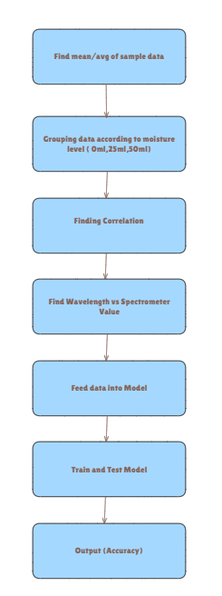
Architecture
Use HeatMap to analyze the dataset
Grouping data as per requirement
Find input and ouput features
Finding relationship between features using correlation
Selecting model
Train model
Test model
Output accuracy

Slide 3
Flow of Execution
Load Data: Reads the dataset from a CSV file.
Extract Information: Extracts Sample Name, Moisture Level, and Reading Number from the Records column using regex.
Data Cleaning: Drops rows where extraction failed and converts Moisture and Reading columns to integers.
Categorize Moisture: Assigns moisture levels as "Low" (0ml), "Medium" (25ml), or "High" (50ml).
Compute Mean: Groups data by Sample and Moisture Level and calculates the mean of readings.
Dataset Splitting: Creates separate datasets for low, medium, and high moisture levels.
Save & Display: Saves the three datasets as CSV files and prints their first few rows.

Slide 4
Categorize Moisture – Classify moisture levels as Low (0ml), Medium (25ml), or High (50ml).
Compute Mean – Group by Sample and Moisture Level, then calculate the mean reading.
Dataset Splitting – Create separate datasets for each moisture level.
Data Preprocessing and Categorization
Analyze correlations using Karl Pearson and Spearman for each soil property
Comparison between both methods for soil properties across Low, Medium and High levels.
It calculates correlation for Ph, Nitro, Posh Nitro and Pota Nitro. Groups data by moisture level and drops missing values. Computes Pearson & Spearman correlations for each property.
Plots heatmaps side by side to compare both correlations visually.

Slide 5
Model Approach & Evaluation Metrics
Machine Learning Models Used:
Gradient Boosting Regressor (GBR): Identifies important wavelengths and predicts soil parameters.
Random Forest Regressor (RFR): Aggregates predictions from multiple trees, handles noisy data well.
XGBoost Regressor (XGBR): Optimized gradient boosting, offers high accuracy through feature importance.
Linear Regression: Baseline model to compare performance with more complex models.
Evaluation Metric:
Evaluates model accuracy in predicting soil parameters at different moisture levels (0ml, 25ml, 50ml).
R2 Score:
Measures how well model predictions match actual data.
R2 = 1: Perfect prediction
R2 = 0: Model performs no better than predicting the mean
Negative R2 : Worse than predicting the mean

Slide 6
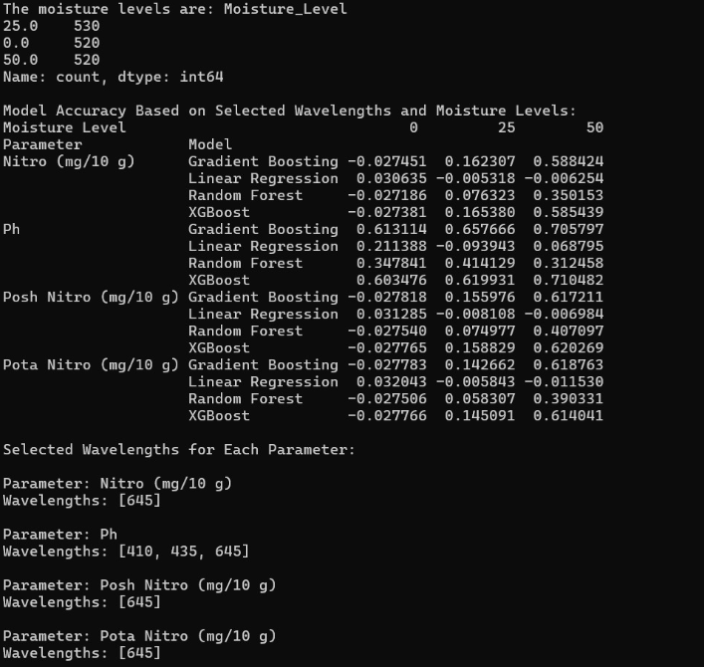
Output

